Slide 1
Predicting MBA Job Placement Outcomes
Newton Mwirebua
BAN 668
Python Programming for Data Analysis

Slide 2

The Problem
Can we predict MBA placement before students enter the job market?
Project Objectives
The Question
1
Build
Given a student's academic record, work history, and interview score, can we predict whether they will be Placed or Not Placed at the end of the MBA program?
A binary classifier that predicts placement status
2
Identify
The variables most strongly driving placement
Why it matters
3
Compare
Career-services teams need to identify at-risk students early
MBA programs want to allocate coaching resources efficiently
Students benefit from personalized intervention before placement season
Logistic Regression, Decision Tree, and KNN
4
Recommend
Actionable steps for MBA career services
2

Slide 3



Data Overview
215 MBA student records, 18 predictors after cleaning
215
20
18
68.8%
31.2%
Students
Raw columns
Predictors used
Placed
Not Placed
Variables in three groups
Academic
Experience
Outcome-stage
ssc_percentage, hsc_percentage, degree_percentage, mba_percent, ssc_board, hsc_subject, undergrad_degree
work_experience, years_experience, internship_completed, num_certifications, emp_test_percentage
specialisation, skills_match_percent, interview_score, gender + the target: status
3

Slide 4


Data Preprocessing
From 20 raw columns to a model-ready feature matrix
1
2
3
4
5
Inspect
Drop Leakage
Engineer
Encode
Split & Scale
0 missing values
All types valid
company_tier &
job_competition_level
AcademicScore (avg)
AcademicLevel (bin)
One-hot dummies,
drop_first=True
80 / 20 stratified
StandardScaler
Target leakage prevention
company_tier and job_competition_level describe the company that hired the student — both are determined AFTER placement. Including them as predictors would leak the answer into the model and inflate test accuracy. Removing them was the most consequential preprocessing decision.
4

Slide 5
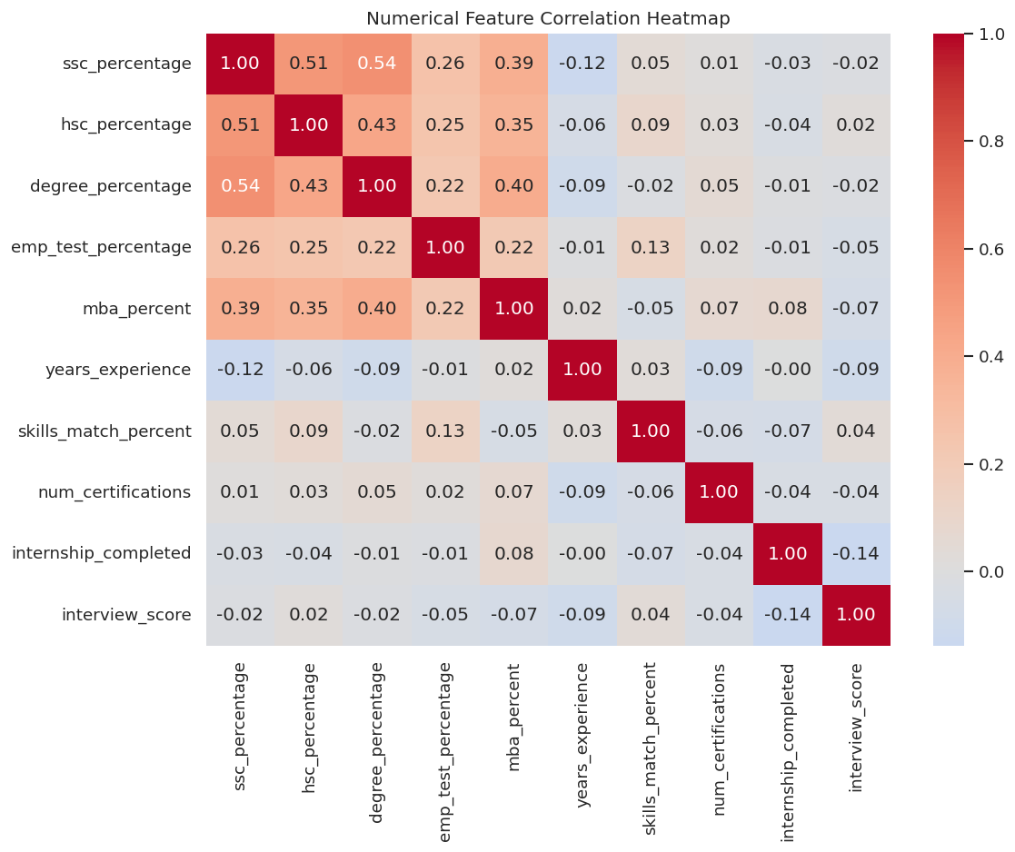
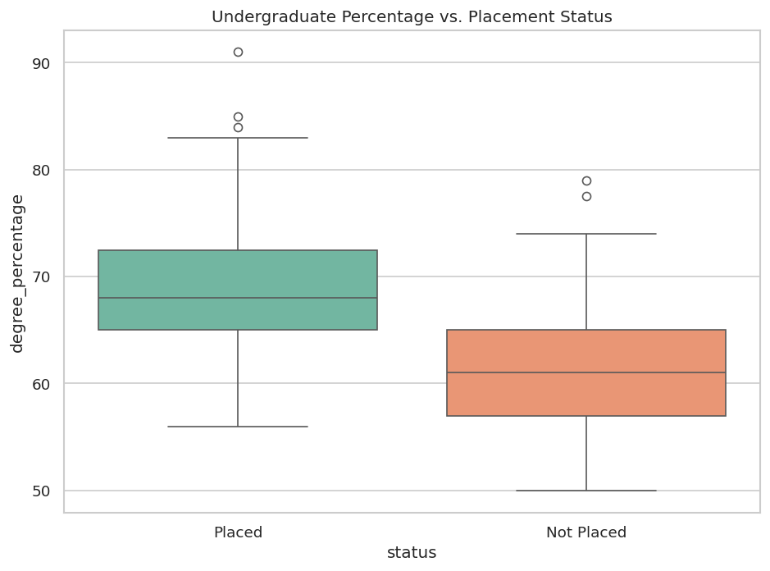
Exploratory Data Analysis
Academic performance separates Placed from Not Placed
Correlation heatmap
Degree % by placement status
5

Slide 6

Key EDA Insights
What the data is telling us before any modeling
Academic performance matters
Placed students have a median degree % around 68% vs ~61% for non-placed. SSC, HSC, and degree % all separate the two groups.
Work experience is a real signal
Students with prior work experience are placed at a noticeably higher rate than those without.
Specialization affects outcomes
Mkt&Fin students out-place Mkt&HR students — a candidate for targeted career-services investment.
Class imbalance is moderate
69% Placed / 31% Not Placed. We use F1 and minority-class recall instead of relying on accuracy.
No multicollinearity red flags
Correlations stay below 0.6, so all predictors can enter the model together.
6

Slide 7
Models Built
Three classifiers spanning linear, tree-based, and instance-based families
Logistic Regression
Decision Tree
K-Nearest Neighbors
Linear, interpretable
Non-linear, rule-based
Instance-based, lazy
How it works
How it works
How it works
Fits a probability function from a weighted sum of features.
Builds a flowchart of yes/no questions on the features.
Predicts based on the 5 most similar students in training data.
In this project
In this project
In this project
Strengths: coefficients show feature importance; works well on small data.
Strengths: captures interactions; weakness: can overfit on small samples.
Strengths: makes no parametric assumptions; sensitive to scale and noise.
7

Slide 8
Baseline Model Comparison
Logistic Regression leads on accuracy and F1
What we see
Logistic Regression wins on every metric: accuracy 0.88, F1 (Placed) 0.92.
Decision Tree drops to 0.77 — likely overfitting on 172 training rows.
KNN underperforms at 0.72 — high-dimensional, scale-sensitive feature space.
Gap of 16+ accuracy points justifies promoting LR to the tuning stage.
8

Slide 9
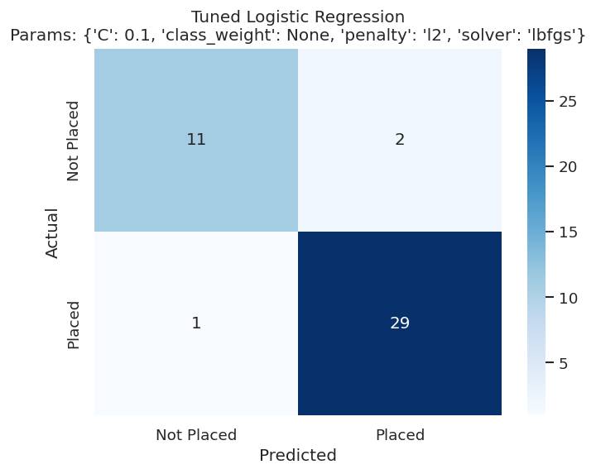
Hyperparameter Tuning
GridSearchCV with 5-fold CV — accuracy jumps to 93%
88%
93%
Baseline accuracy
Tuned accuracy
0.92
0.95
Baseline F1 (Placed)
Tuned F1 (Placed)
Best params: C = 0.1 • penalty = l2 • solver = lbfgs
Tuned LR confusion matrix on 43 test students
9

Slide 10
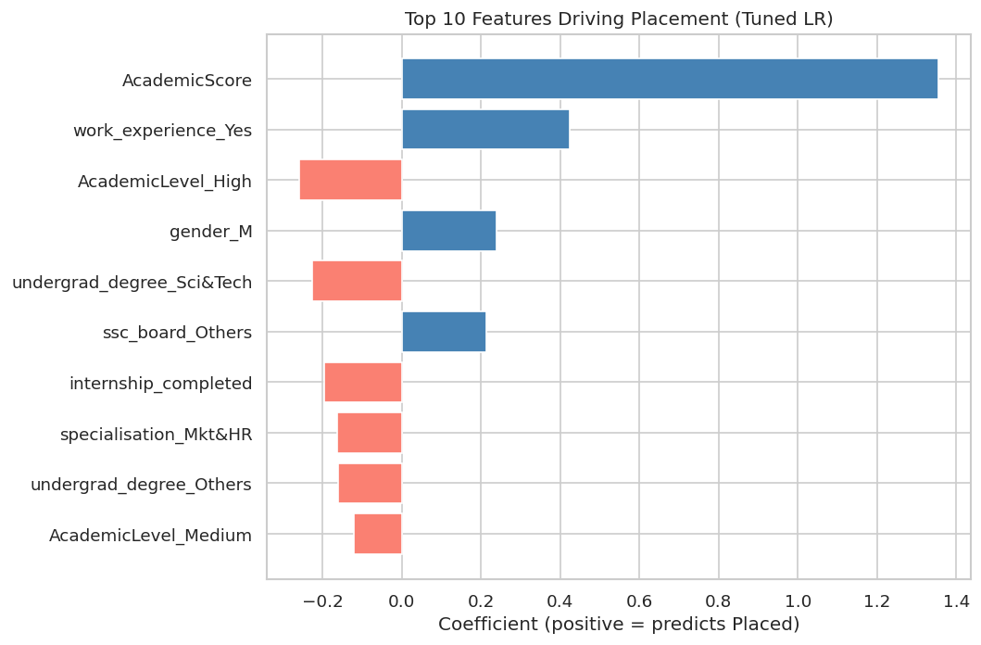
What Drives Placement?
Standardized coefficients from the tuned Logistic Regression
Top 3 takeaways
1
AcademicScore
The combined SSC + HSC + degree average is the single largest positive driver.
2
work_experience
Prior work experience meaningfully raises placement probability.
3
specialisation
Mkt&HR carries a small negative coefficient vs Mkt&Fin.
10

Slide 11




Recommendations for MBA Career Services
From model output to action
Build a placement-risk dashboard
Expand internship pipelines
Score each new student on admission. Flag those with predicted probability below 0.5 for proactive outreach.
Even short work experience materially raises placement odds — credit short-term project work.
Strengthen the Mkt&HR pipeline
Audit for fairness before deployment
Lower placement rate vs Mkt&Fin. Target HR-focused employer outreach and alumni mentorship.
Check disparate impact across gender and degree-type subgroups. Pair any rollout with monitoring.
11

Slide 12
Thank you
Questions & discussion
Project at a glance
93%
0.95
0.88
18
Final accuracy
F1 (Placed)
F1 (Not Placed)
Predictors used

